Slide 1


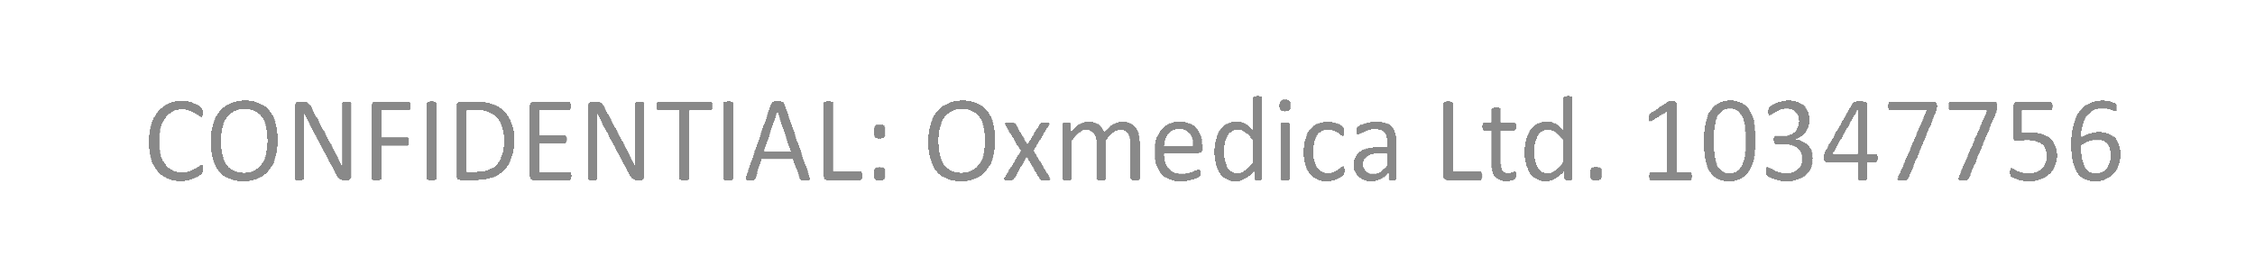
A New Age of Fabrication
Omar Choudhry
Oxmedica-Mawhiba Summer Tech Summit 2024
Notes:
السلام عليكم ورحمة الله وبركاته
بِسْمِ اللَّهِ الرَّحْمَٰنِ الرَّحِيمِ
اِنَّ الْحَمْدُ لِلَّهِ نَحْمَدُهُ وَنَسْتَعِينُهُ وَنَسْتَغْفِرُهُ
وَنَعُوذُ بِاللَّهِ مِنْ شُرُورِ أَنْفُسِنَا وَمِنْ سَيِّئَاتِ أَعْمَالِنَا
مَنْ يَهْدِهِ اللَّهُ فَلَا مُضِلَّ لَهُ
وَمَنْ يُضْلِلْ فَلَا هَادِيَ لَهُ
وَأَشْهَدُ أَنْ لَا إِلَهَ إِلَّا اللَّهُ وَحْدَهُ لَا شَرِيكَ لَهُ
وَأَشْهَدُ أَنَّ مُحَمَّدًا عَبْدُهُ وَرَسُولُهُ
يَا أَيُّهَا الَّذِينَ آمَنُوا اتَّقُوا اللَّهَ حَقَّ تُقَاتِهِ
وَلَا تَمُوتُنَّ إِلَّا وَأَنْتُمْ مُسْلِمُونَ
يَـٰٓأَيُّهَا ٱلنَّاسُ ٱتَّقُوا۟ رَبَّكُمُ ٱلَّذِى خَلَقَكُم مِّن نَّفْسٍۢ وَٰحِدَةٍۢ
وَخَلَقَ مِنْهَا زَوْجَهَا وَبَثَّ مِنْهُمَا رِجَالًۭا كَثِيرًۭا وَنِسَآءًۭ ۚ
وَٱتَّقُوا۟ ٱللَّهَ ٱلَّذِى تَسَآءَلُونَ بِهِۦ وَٱلْأَرْحَامَ ۚ
إِنَّ ٱللَّهَ كَانَ عَلَيْكُمْ رَقِيبًۭا
يَـٰٓأَيُّهَا ٱلَّذِينَ ءَامَنُوا۟ ٱتَّقُوا۟ ٱللَّهَ وَقُولُوا۟ قَوْلًۭا سَدِيدًۭا
يُصْلِحْ لَكُمْ أَعْمَـٰلَكُمْ
وَيَغْفِرْ لَكُمْ ذُنُوبَكُمْ ۗ
وَمَن يُطِعِ ٱللَّهَ وَرَسُولَهُۥ
فَقَدْ فَازَ فَوْزًا عَظِيمًا
إِنَّ أَصْدَقَ الْحَدِيثِ كِتَابُ اللَّهِ
وَأَحْسَنَ الْهَدْيِ هَدْيُ مُحَمَّدٍ صَلَّى اللَّهُ عَلَيْهِ وَسَلَّمَ
وَشَرُّ الْأُمُورِ مُحْدَثَاتُهَا
وَكُلُّ مُحْدَثَةٍ بِدْعَةٌ
وَكُلُّ بِدْعَةٍ ضَلَالَةٌ
وَكُلُّ ضَلَالَةٍ فِي النَّارِ
Thumma ’Amma-Ba’du
My name is Omar and Bi-Fadli-Allahi-Ta’alaa I am delighted to welcome you all to the Oxmedica-Mawhiba Tech Summit 2024 in Riyadh.
To open the summit, I would like to discuss a pressing issue in this digital era – ‘A New Age Of Fabrication.’
إن شاء الله We'll explore how AI is reshaping our reality.

Slide 2
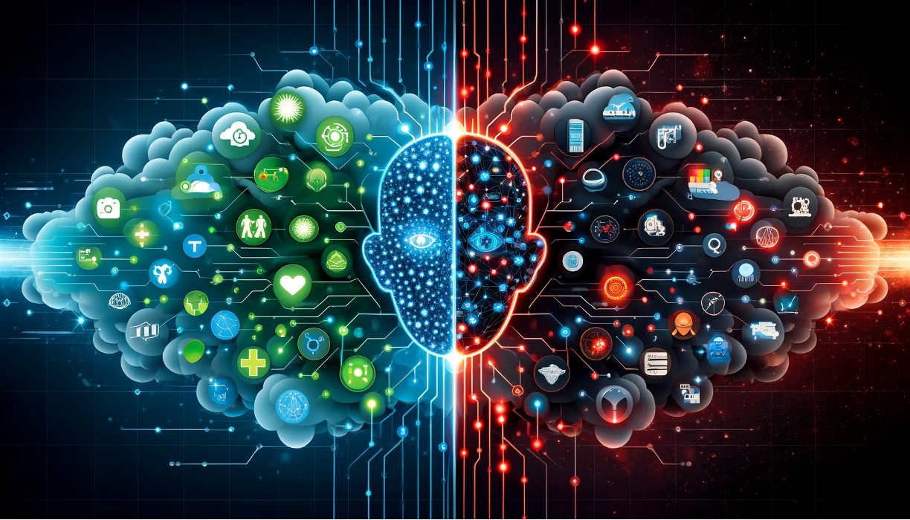
A Double-Edged Sword
Notes:
AI is a double-edged sword. Whilst it has brought remarkable advancements, it also harbours potential threats.
Some people talk about AI as a bubble – so I will summarise to you what the famous billionaire Mark Cuban recently said –
the fact we do not see companies flooding the stock markets with gimmicky AI models, and we have evidence of the technological advancements –
it is clear that we are not in an AI bubble.
But Newton’s third Law teaches us that for every action, there is an equal and opposite reaction.
When we consider such incredible achievements of AI, there is no doubt that we will see the harms and threats alongside.

Slide 3
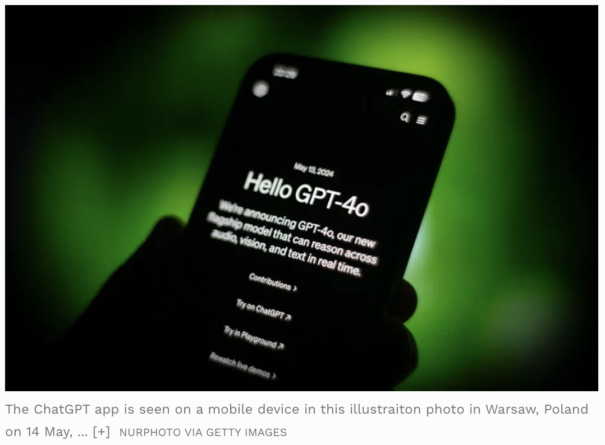
Notes:
ChatGPT has seen incredible progression over the last few months, let alone in the past few years.

Slide 4
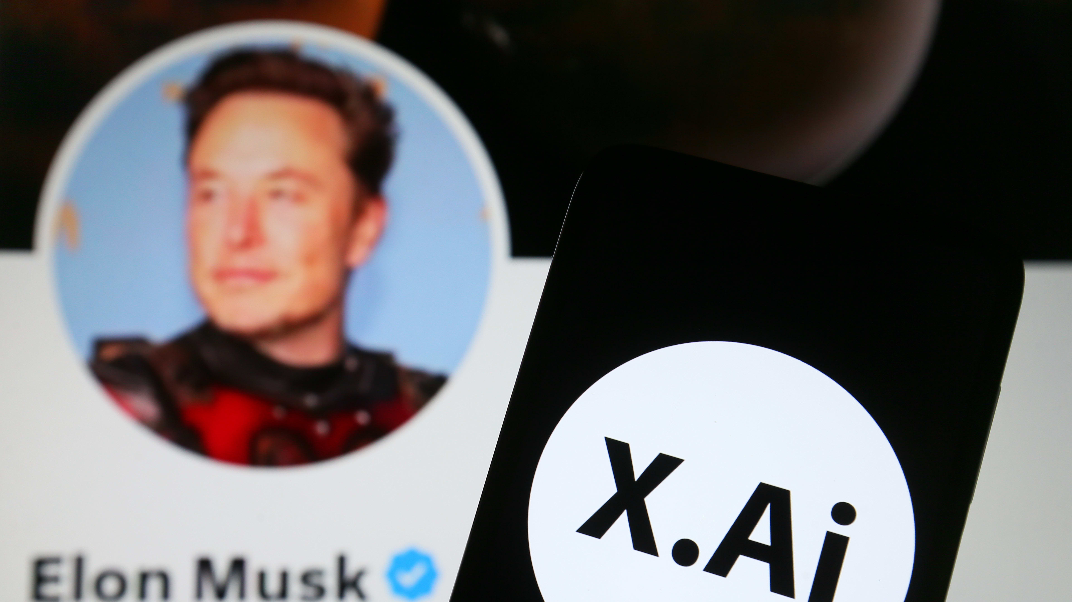
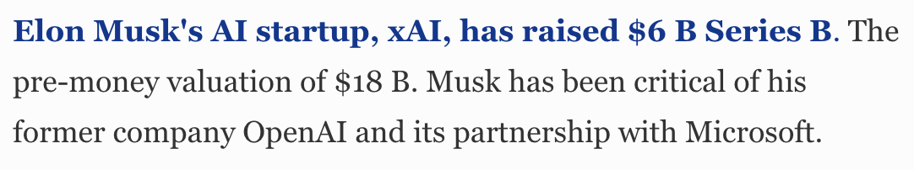
Notes:
Or how about when we see Elon Musk breaking records for his startup xAI,
attempting to be a rival to leaders in the tech and AI space, in seeding and valuation?

Slide 5
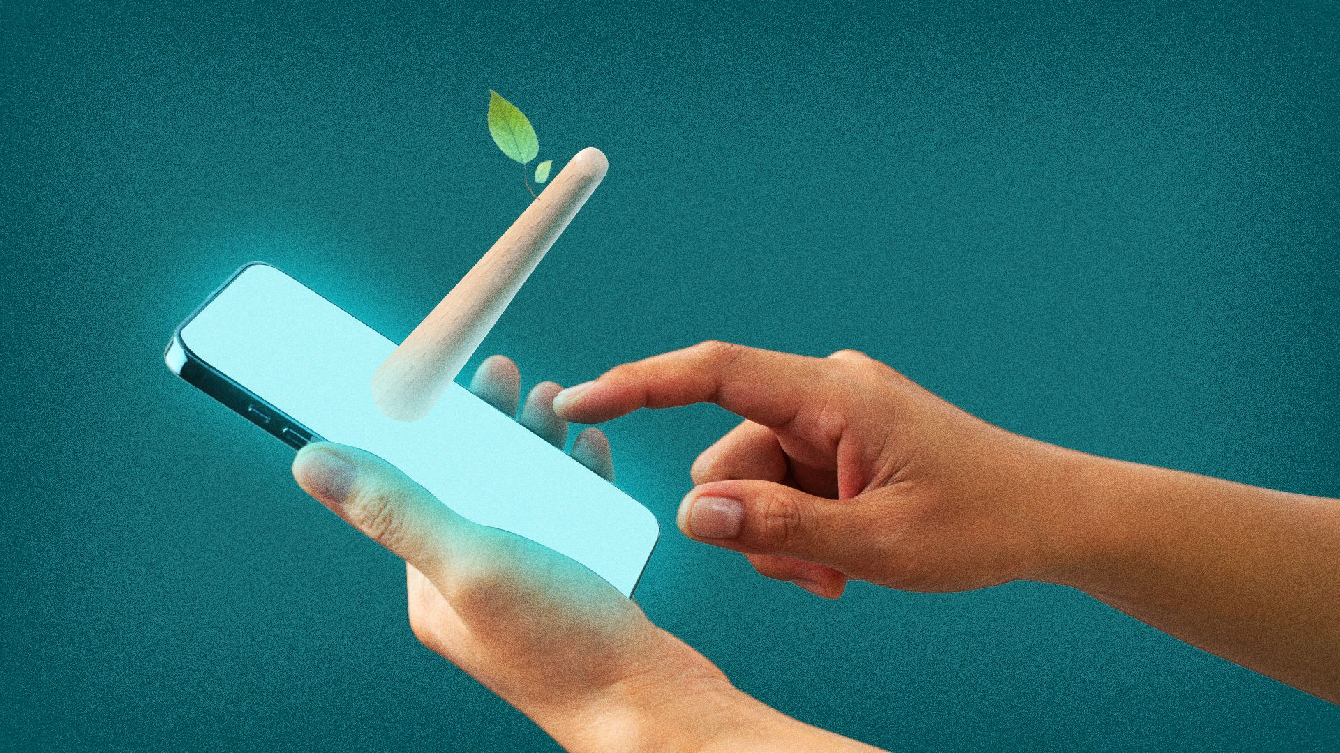
Fool Me Once?
Notes:
Nonetheless, we also see the rapid rise of AI-generated misinformation.
This is part of a bigger picture, which I would like you to learn about today – Fake News, Deepfakes and Online Echo Chambers.
These are not just abstract concepts, but tangible issues that affect us all.

Slide 6
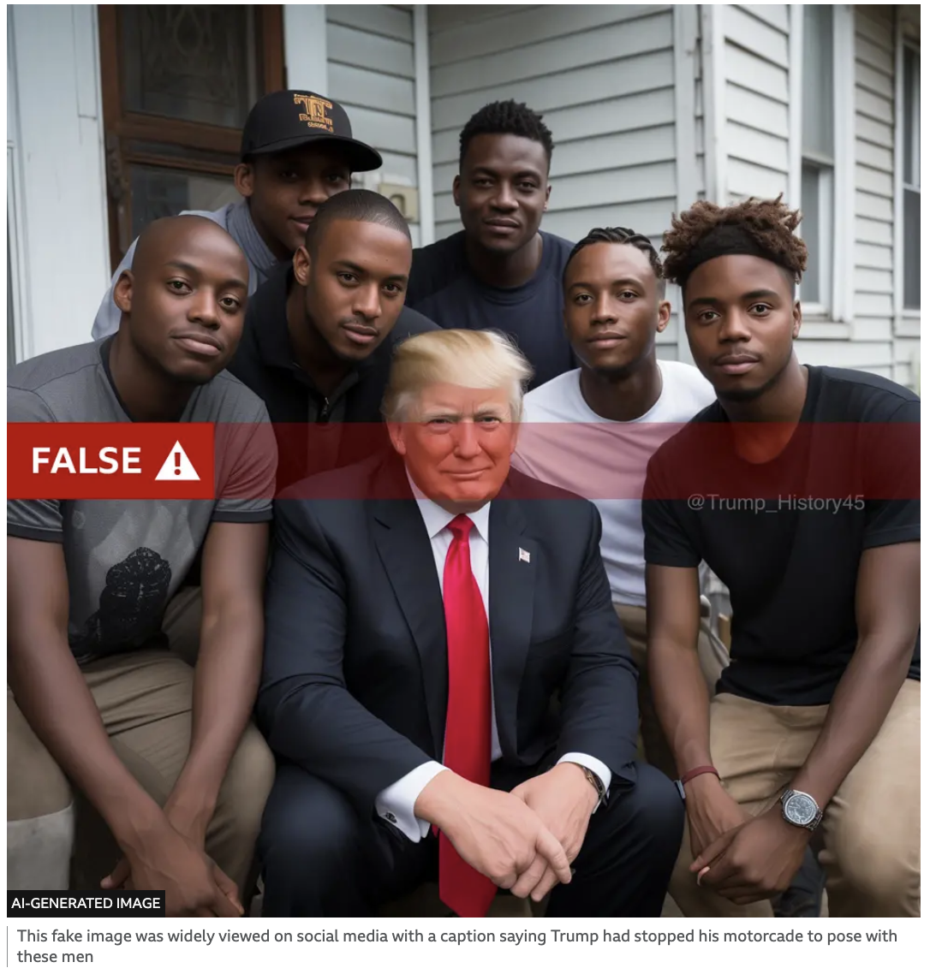
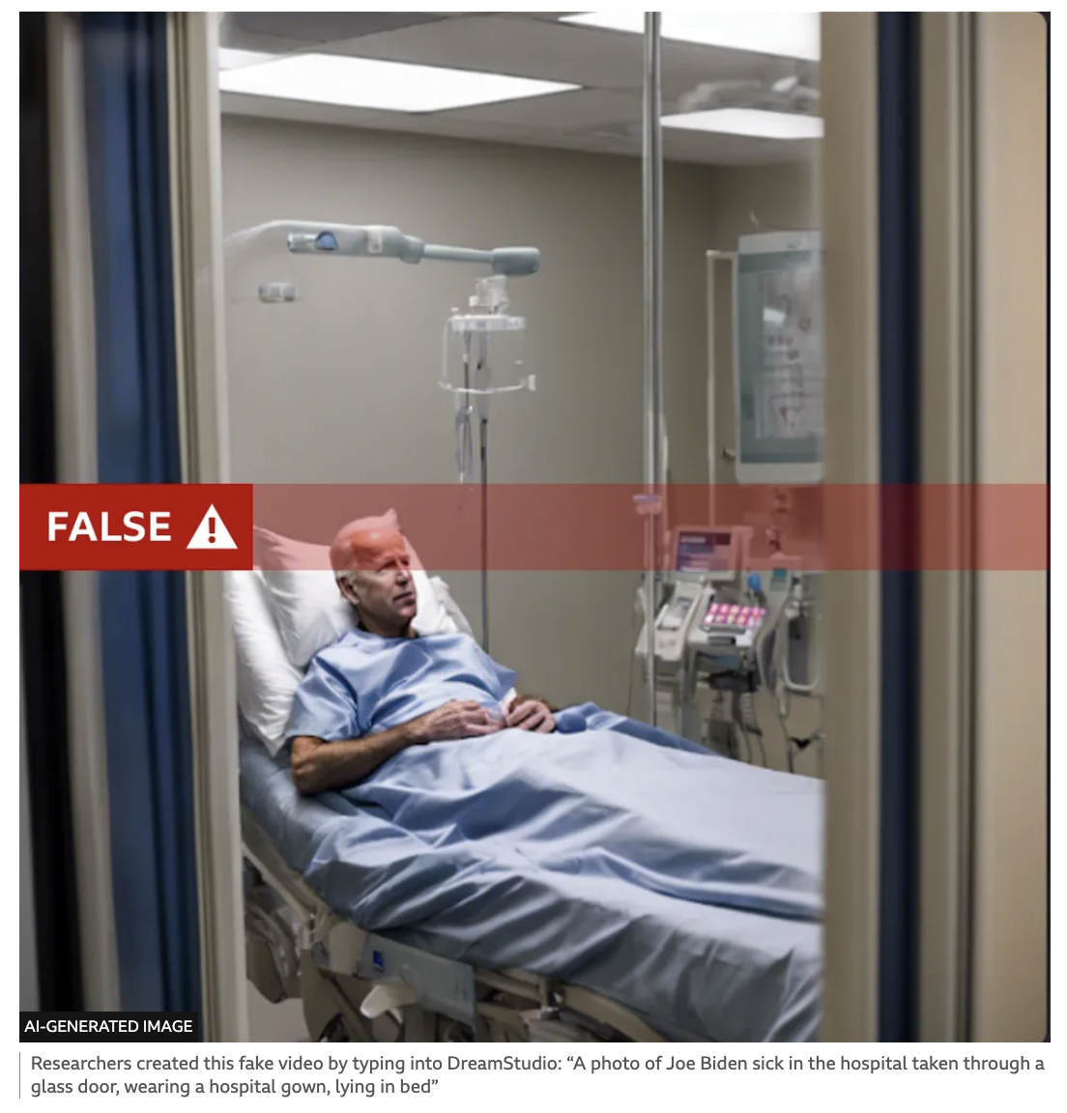
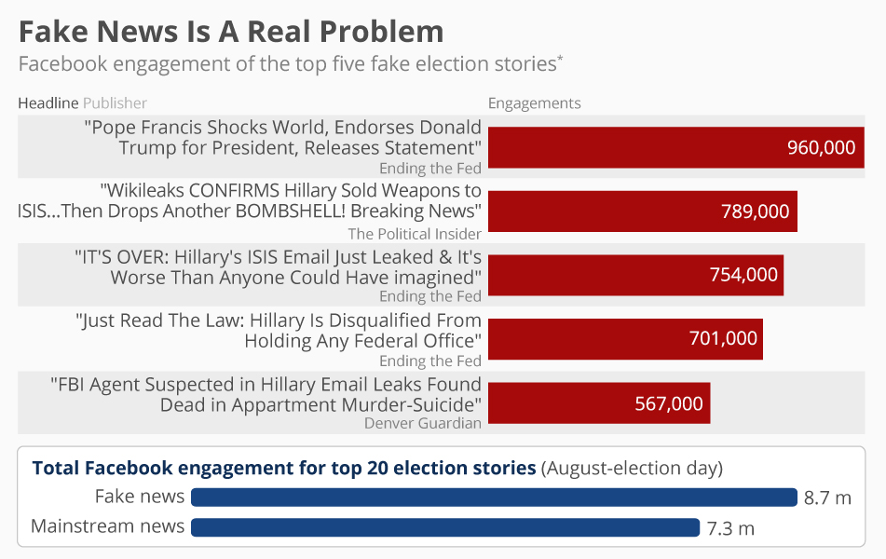
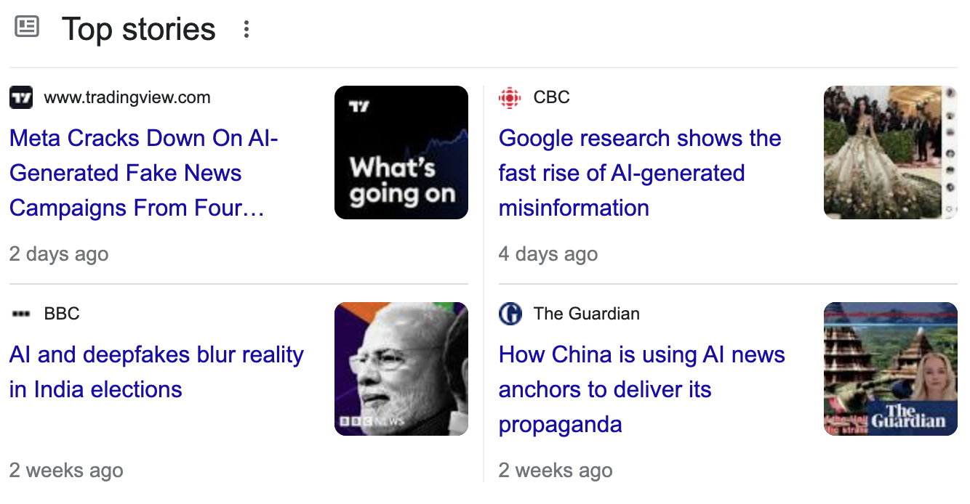
Notes:
Hands up if any of you have ever heard of the term “Fake News”.
And you all know how easy it is to be fooled, and for misinformation to spread.
AI can generate incredibly realistic yet entirely fabricated news articles and videos.
These are not merely amusing tricks; they can influence public opinion and potentially sway elections.
During the 2016 US elections, fake news articles outperformed genuine news on social media – should we not question whether this impacted voters’ opinions?
The difference is that the technological landscape has evolved since 2016 - AI-generated news articles and videos can appear authentic but are entirely fabricated.

Slide 7
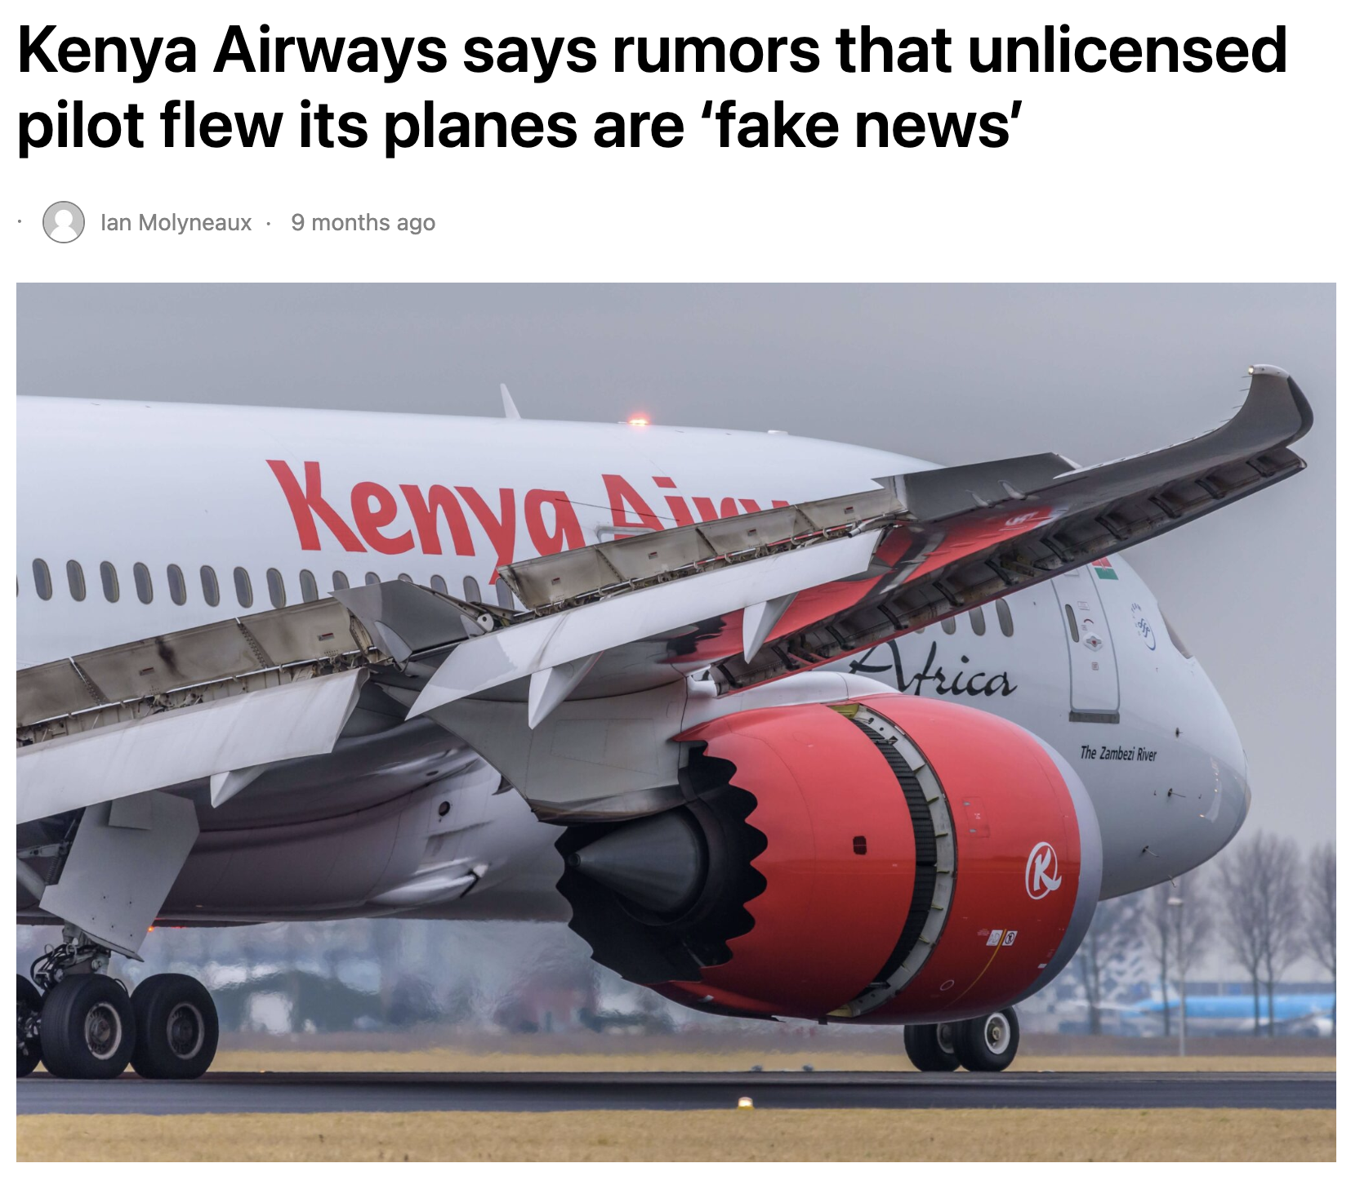
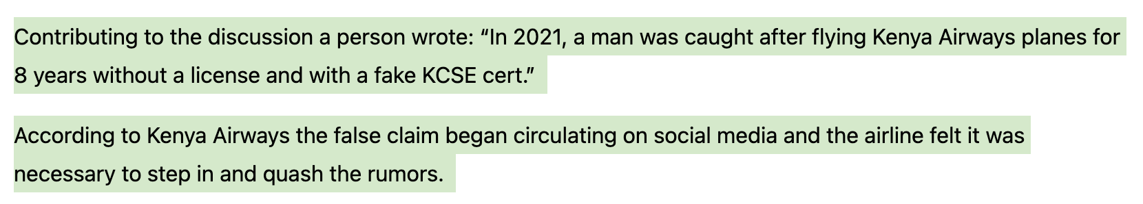
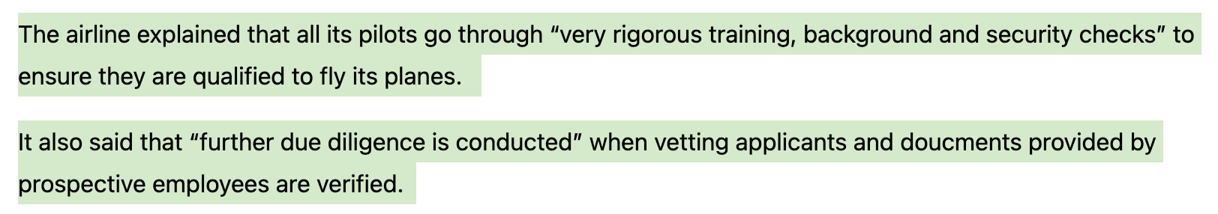
Notes:
No doubt that fake news affects all industries including the focus of today – aerospace.
The danger with fake news is that it is extremely difficult to reverse its effects and rectify the consequences after such media is out there on the internet.
No doubt some people, even after all of this, will feel a certain type of way when thinking about taking this airline where a pilot of Kenya Airways were accused of flying for nearly a decade without a license.

Slide 8
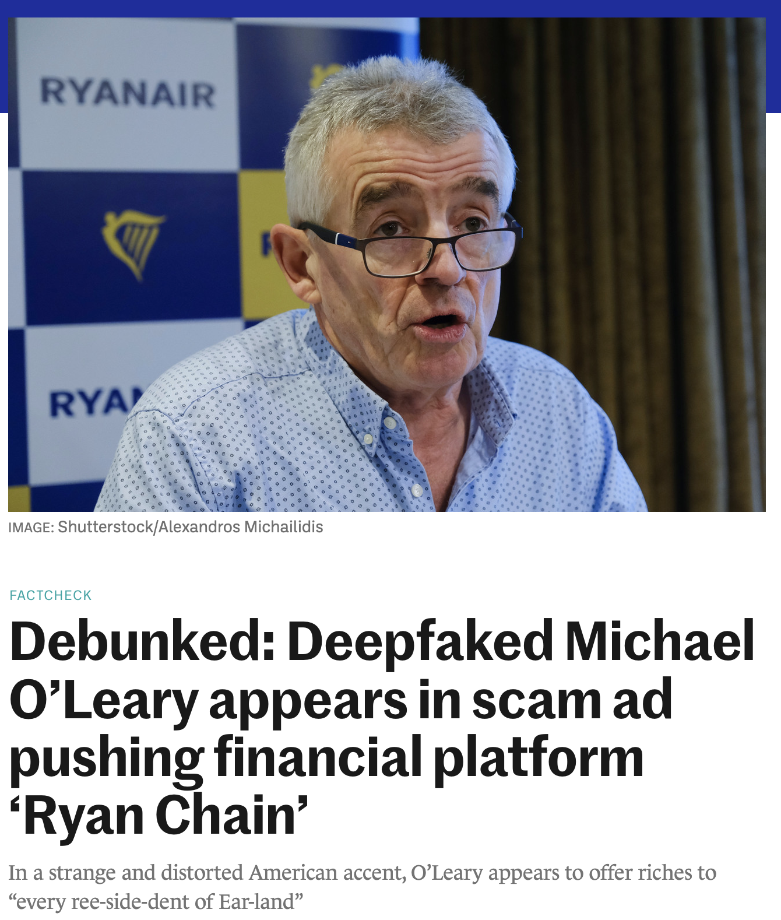
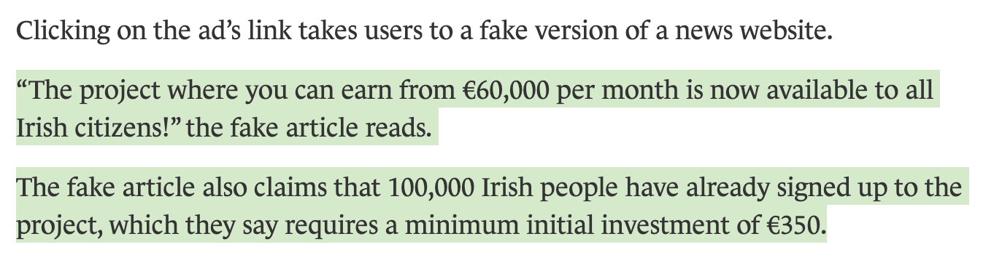
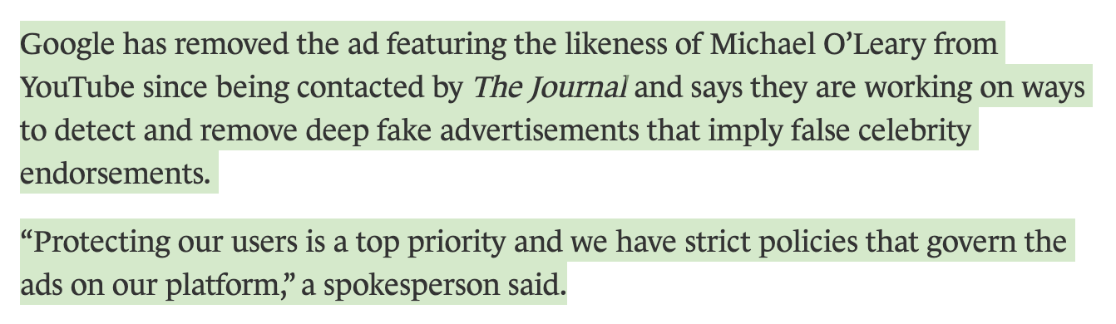
Notes:
But AI can enhance the severity of these issues, causing more people to fall for and believe in them.
This is the CEO of an airline company Ryan Air, where AI was used to impersonate him, promoting a cryptocurrency project. No doubt because people exist who trust him, they may have fell victim to this scam.

Slide 9
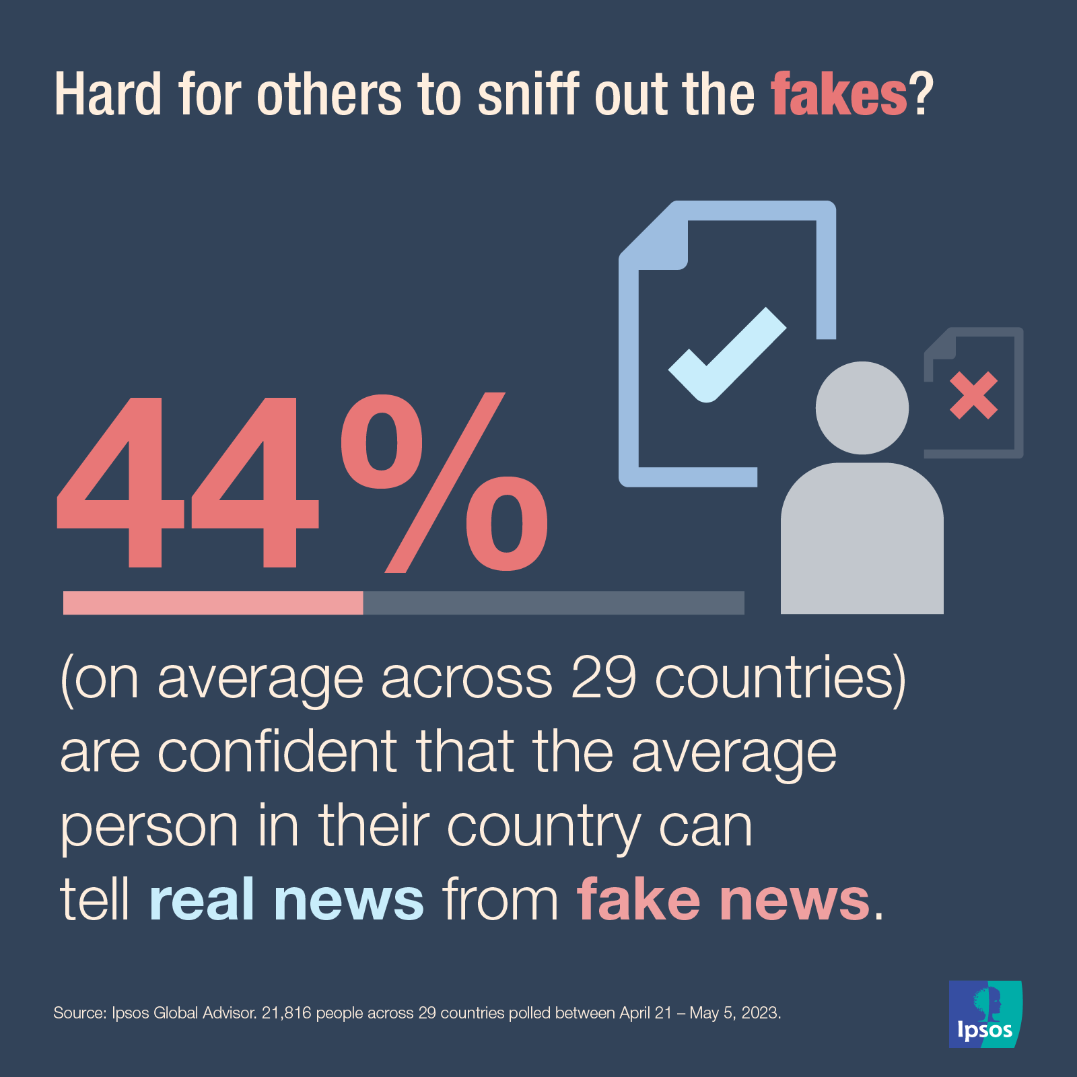
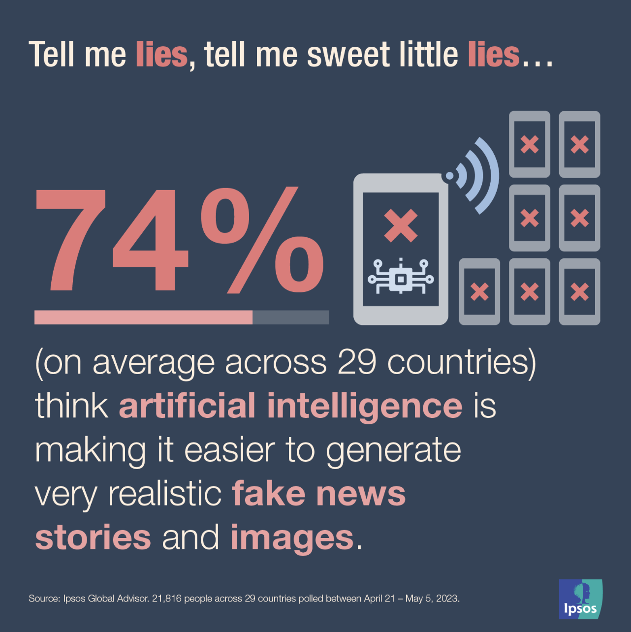
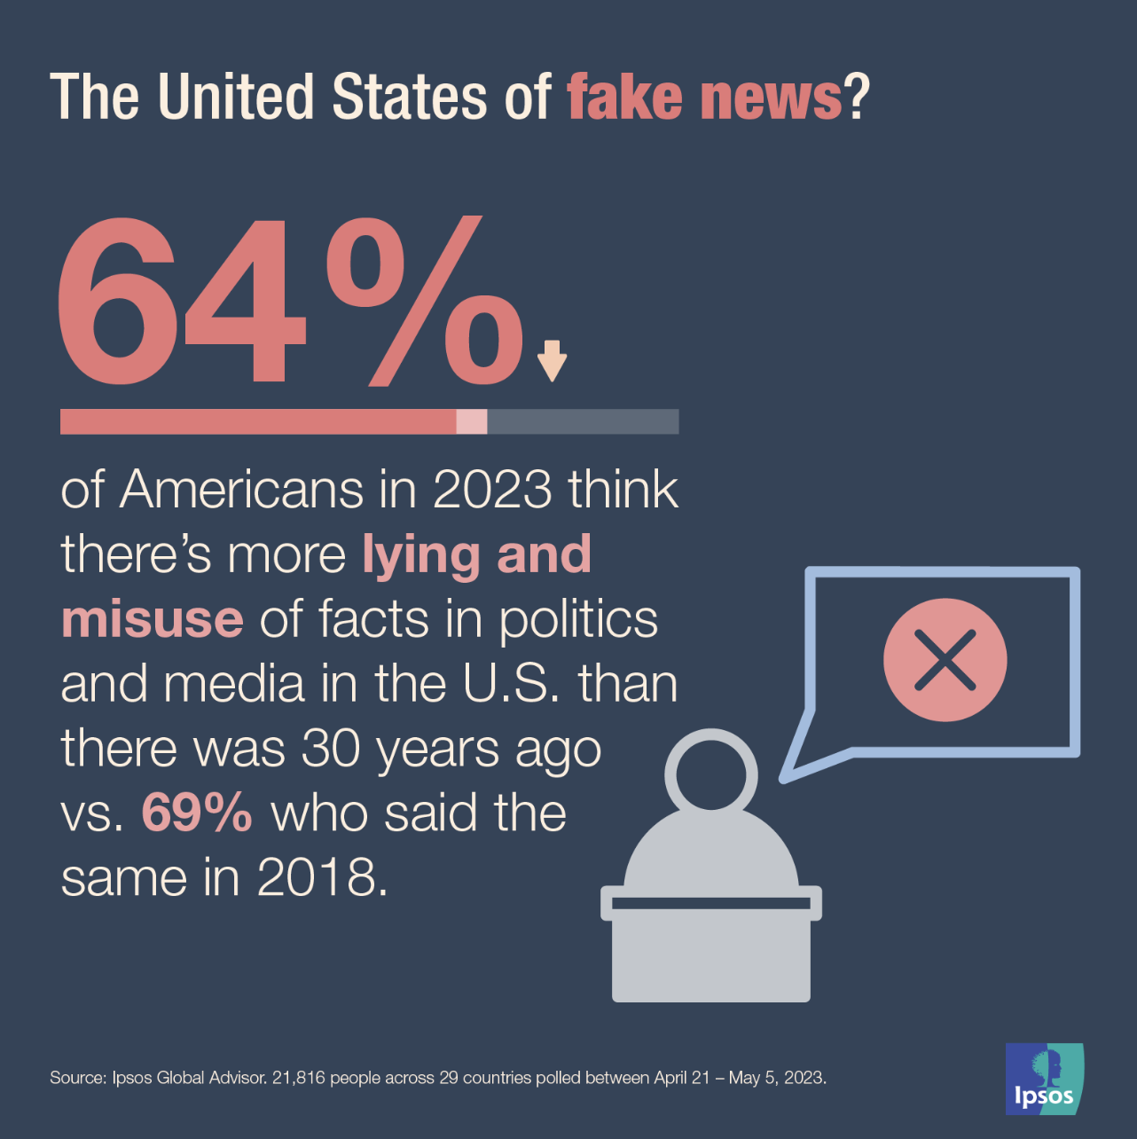
Notes:
AI uses sophisticated algorithms, like Natural Language Processing, to create convincing text,
and Generative Adversarial Networks, or GANs, to produce realistic images and videos.
Combined with data harvested from social media, these tools can target individuals with precision, manipulating their views without their consent.
This causes the erosion of public trust, and it becomes increasingly difficult to distinguish between true and false information.

Slide 10
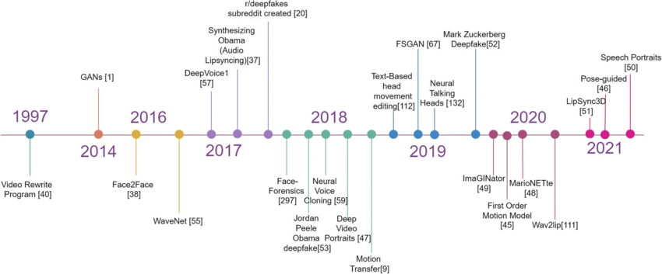
Notes:
Next, we have Deepfakes. Originally, these AI-generated synthetic media focused on explicit content.
However, their use has expanded to professional theft, social engineering, and even falsified religious verdicts.
It would not do it justice to summarise the timeline (point backwards) in the last few years, so let us take a look at some examples.

Slide 11
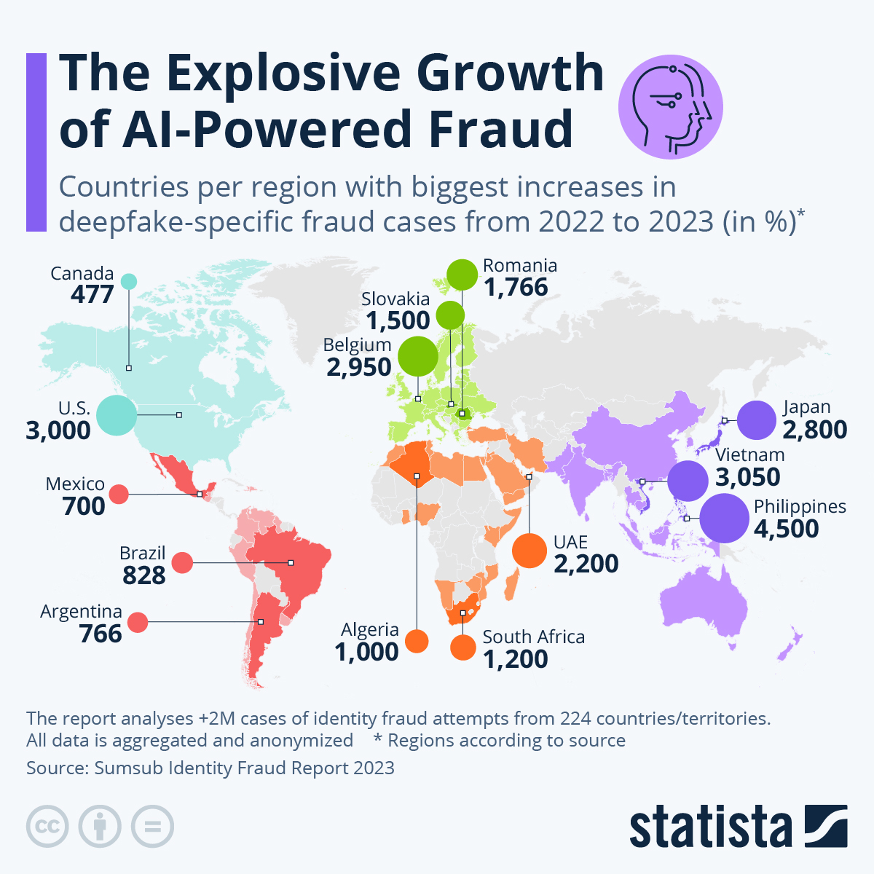
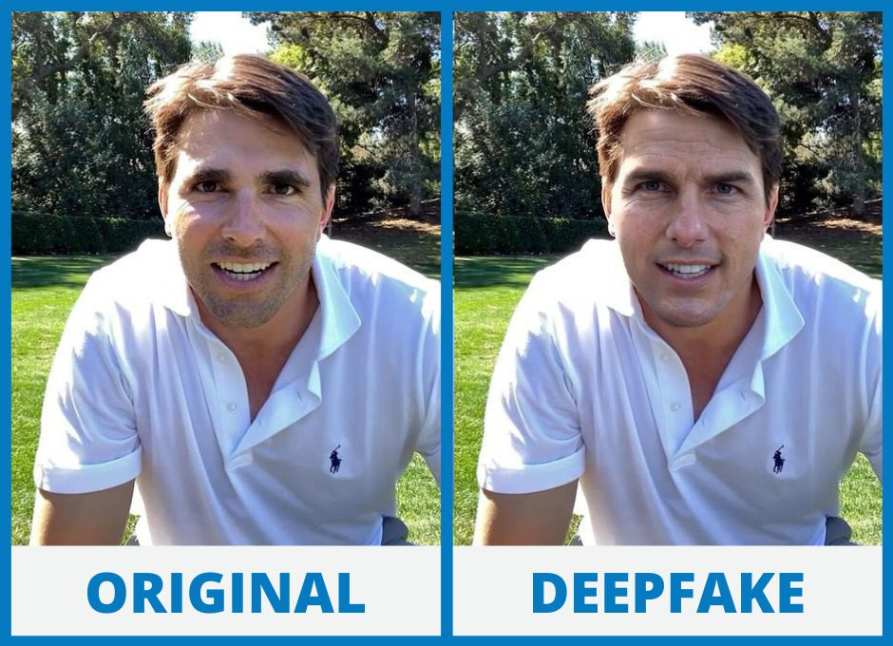
Notes:
Deepfakes do not only apply just to images.
We saw examples of Presidents Trump and Biden earlier.
They also apply to audios through AI voice cloning.

Slide 12
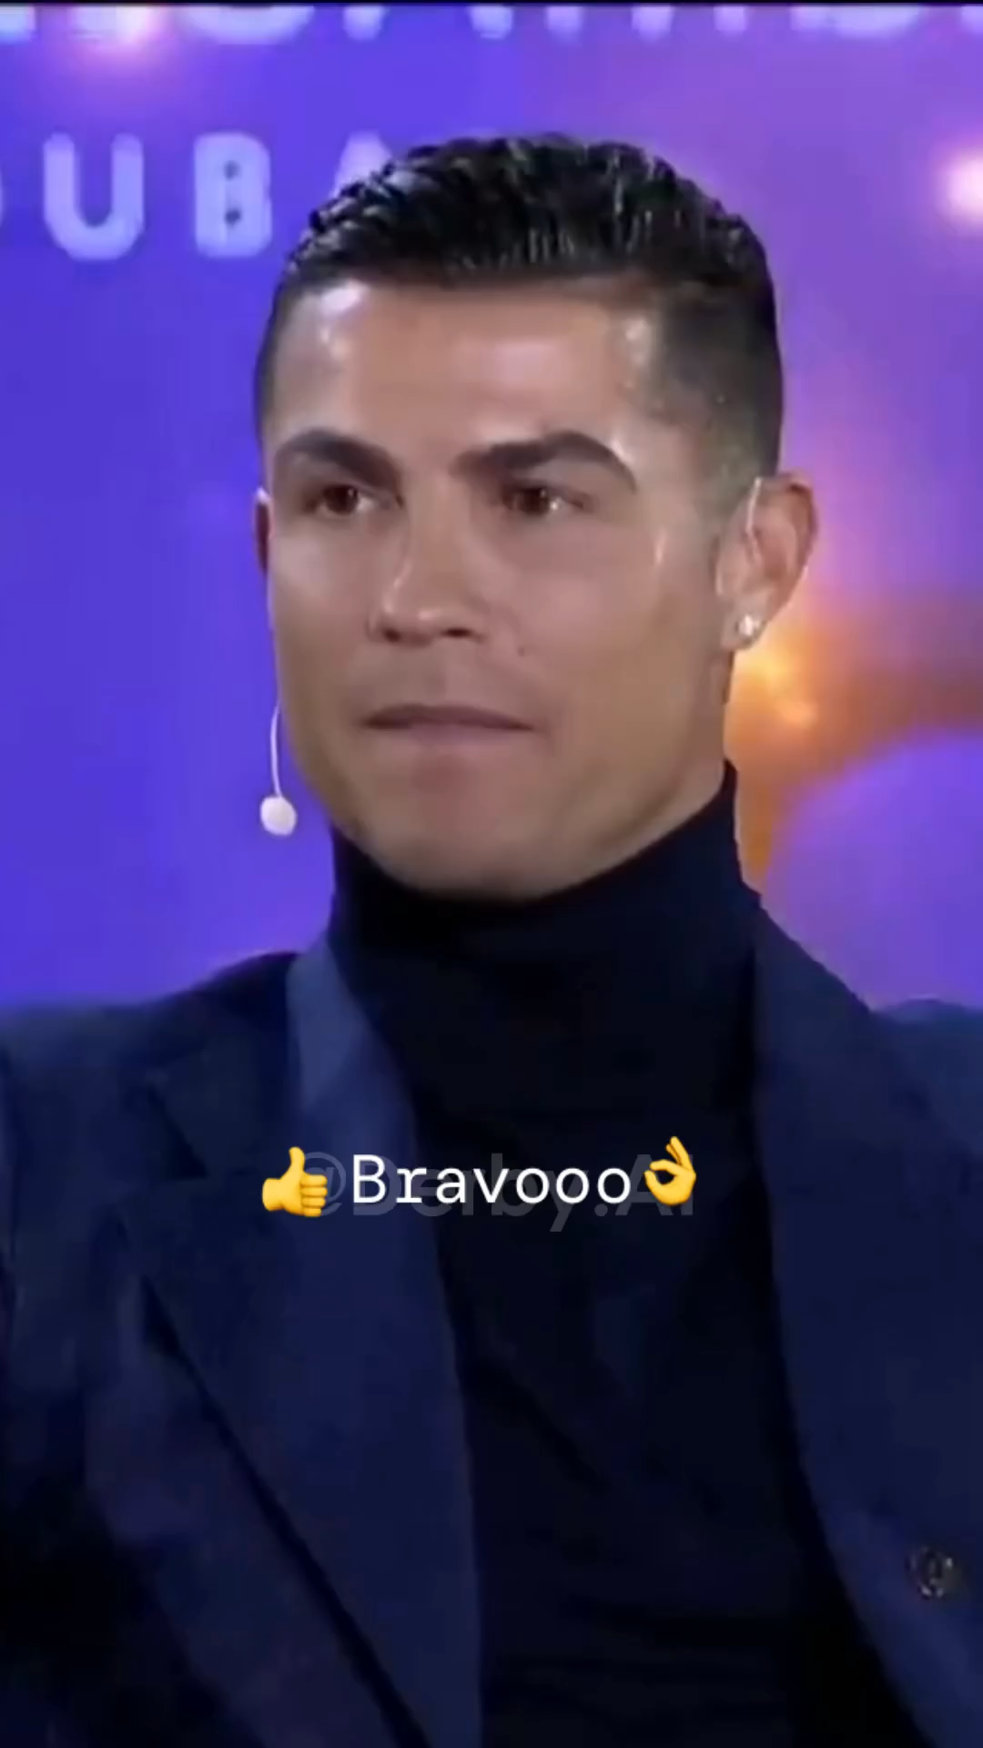
Notes:
AI can be used to mimic the voice of anyone.

Slide 13
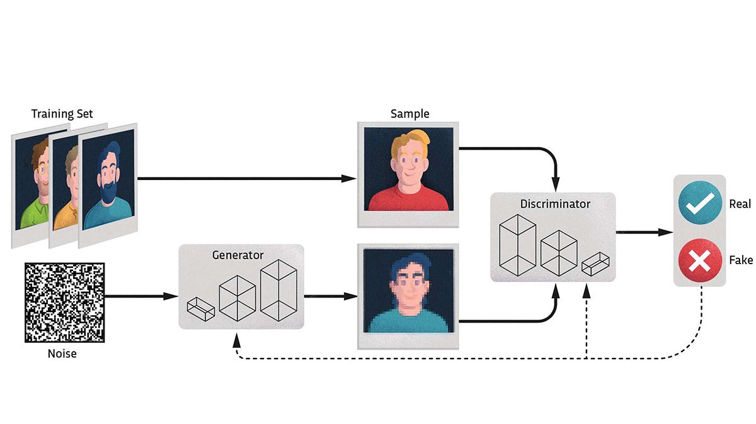
Notes:
Now let’s take a brief look at some of the technology behind this.
Deepfakes rely on GANs to swap faces in videos, making it hard to distinguish real from fake.
The threat is significant: from identity theft to financial fraud,
and from manipulating public figures to spreading misinformation.
AI tools are being developed to detect deepfakes,
but the technology is evolving rapidly, making it a constant battle.
What you are seeing here is a brief overview of how a GAN works.
We have a training set,
which is basically just a bunch of real images
(we would consider this a high dimensional latent space).
Then we have some noise (just randomness in an image, which we would consider low dimensional latent space).
A GAN is an adversarial network – meaning it involves two components which battle against each other.
The generator attempts to take this noise, and make realistic images.
The discriminator tries to determine whether or not the image its given is real or fake.
Over time, the discriminator gets better at choosing between real and fake images.
This information is given to the generator which gets better at producing more and more realistic images.
This feedback loop constantly improves both of these models,
and thus we end up with a model that can be used to create fake images.
With a little bit of tuning and expertise, we can start to produce all sorts of fake images, videos and audios.

Slide 14
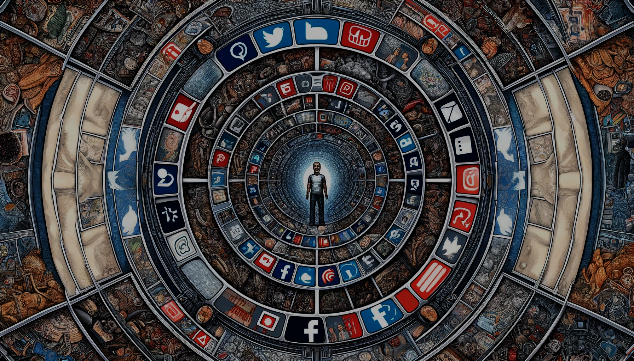
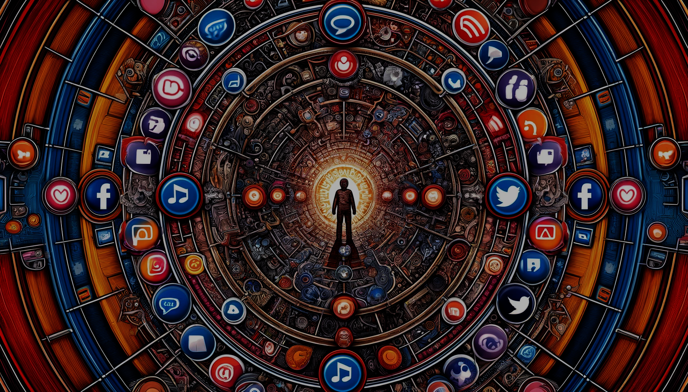
Echo Chambers
Notes:
Finally, let’s talk about the Social Media and online platform Echo Chambers.
AI-driven algorithms on social media platforms curate personalised content, reinforcing users' existing beliefs.
This can lead to polarisation, as people are less exposed to diverse viewpoints.
What ends up happening is most people do not post anything.
It is the extreme minority which do.
And this minority are at such extremes of all spectrums
That is what you and I, think the world is like.
But when you go out and actually meet real people, you realise just how wrong your perception was and how toxic these places can be.

Slide 15
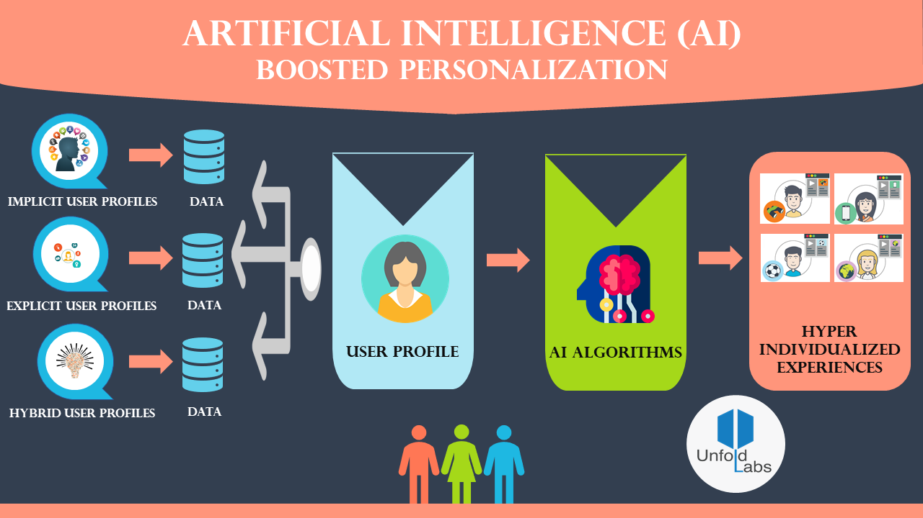
Notes:
These algorithms prioritise engagement, showing users content that keeps them on the platform longer.
This often means more sensational, polarising content.
The result?
Communities become more divided, and misinformation spreads more easily.
These hyper individualised experiences are what cause you to feel so much strong emotions online,
and are reasons for you to doomscroll on TikTok, Instagram Reels or YouTube Shorts.
Whilst we can propose a solution in promoting diverse content and raising awareness about the impact of echo chambers –
the most important thing is what each and every one of us can do individually.

Slide 16
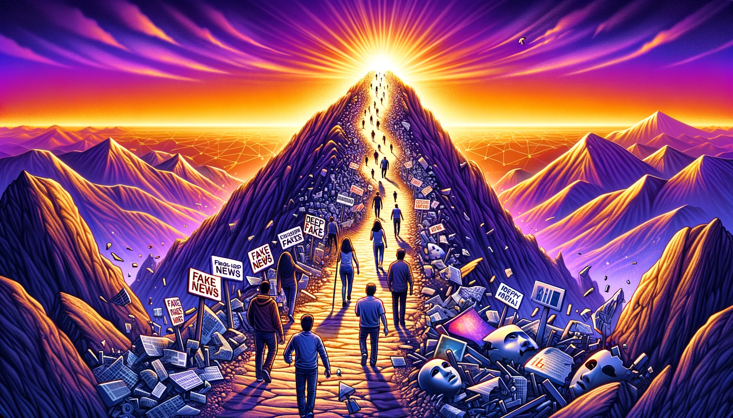
Notes:
Here is the simplest conclusion I can give.
There is an evolving threat of fake news and deepfakes.
Social media is taking up more and more of your time and thoughts.
AI will continue to accelerate this process.
So, prepare yourselves for the upcoming era of misinformation
by focusing on the importance of critical thinking, media literacy, and technical literacy.

Slide 17
A New Age of Fabrication
Omar Choudhry (O.Choudhry@leeds.ac.uk)
Oxmedica-Mawhiba Summer Tech Summit 2024
Notes:
Thank you for your attention, جزاك الله خيرا .

